Slide 1
SATHIYA S
821721243048
B.TECH –ARTIFICIAL INTELLIGENCE AND DATA SCIENCE
SIR ISSAC NEWTON COLLEGE OF ENGINEERING AND TECHNOLOGY

Slide 2
HANDWRITTEN DIGIT CLASSIFICATION(CNN)

Slide 3


AGENDA
Problem statement
Project overview
Who are the end users?
Your solution and its value proposition
The wow in your solution
Modelling
Result

Slide 4

PROBLEM STATEMENT
The problem statement of handwritten digit classification involves developing a machine learning model capable of accurately identifying handwritten digits from images. This task is a fundamental problem in the field of computer vision and pattern recognition. The MNIST dataset is commonly used for this task, consisting of 28x28 grayscale images of handwritten digits (0-9).Given an input image of a handwritten digit, the objective is to train a model that can correctly classify the digit it represents.

Slide 5

PROJECT OVERVIEW
The project aims to develop a system for handwritten digit classification using machine learning techniques, specifically focusing on the MNIST dataset. Handwritten digit classification has applications in various fields such as optical character recognition (OCR), automated form processing, and digitizing historical documents.

Slide 6

WHO ARE THE END USERS?
The end users of this system could include:
Researchers and practitioners in the field of computer vision and machine learning who require accurate digit recognition algorithms.
Companies or organizations that need to automate processes involving handwritten digit input, such as postal services for sorting mail, financial institutions for processing checks, or educational institutions for grading exams.

Slide 7

YOUR SOLUTION AND ITS VALUE PROPOSITION
The solution involves building a convolutional neural network (CNN) model using deep learning frameworks like TensorFlow or Keras. The model will be trained on the MNIST dataset to accurately classify handwritten digits. The value proposition of this solution includes:1. Accuracy: The model will be trained to achieve high accuracy in recognizing handwritten digits, enabling reliable digit classification in real-world applications.2. Efficiency: Once deployed, the system will be capable of processing large volumes of handwritten digit images quickly and accurately, improving efficiency and reducing manual effort.3. Versatility: The trained model can be integrated into various applications and workflows that require handwritten digit recognition, offering versatility and adaptability to different use cases.

Slide 8

THE WOW IN YOUR SOLUTION
The wow factor in this solution lies in its ability to accurately classify handwritten digits with high precision and efficiency. By leveraging advanced machine learning techniques, the system can achieve levels of accuracy comparable to or even surpassing human performance in digit recognition tasks. Additionally, the seamless integration of the model into existing workflows and applications enhances its practical utility and value.
3/21/2024 Annual Review
8

Slide 9
MODELLING
The modelling process involves:
Data preprocessing: Preparing the MNIST dataset by reshaping the images and normalizing pixel values.
Model architecture design: Creating a CNN model architecture with appropriate convolutional and pooling layers followed by fully connected layers for classification.
Model training: Training the CNN model on the training data using optimization algorithms like Adam and monitoring performance on validation data
Model evaluation: Evaluating the trained model on the test data to assess its accuracy and generalization performance.
Deployment: Integrating the trained model into applications or systems where handwritten digit classification is required, ensuring seamless operation and reliability.
Overall, the project aims to deliver a robust and efficient solution for handwritten digit classification, catering to the needs of end users across various domains.
9

Slide 10
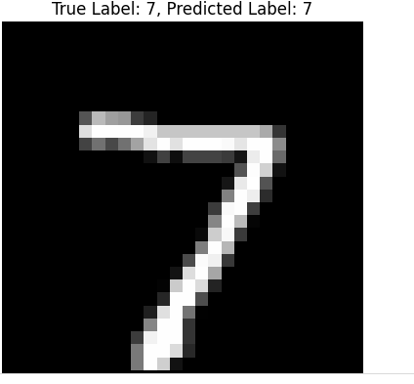
RESULTS
10

